Slide 1
2ECOE76 MATLAB for Engineers Lecture 4
Prepared by
-Twinkle Bhavsar

Slide 2
Outline
Logical Data Type
Logical Functions
Branches
Plotting Features

Slide 3
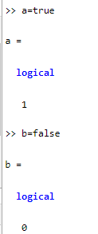


Logical Data Type
It is a special type of data that can have one of only two possible values: 1 or 0. These values are produced by the two special functions true and false.

Slide 4
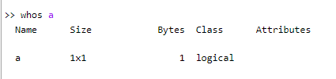
If this variable is examined with the “whos” command, we can see that it has the logical data type:

Slide 5
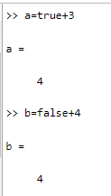




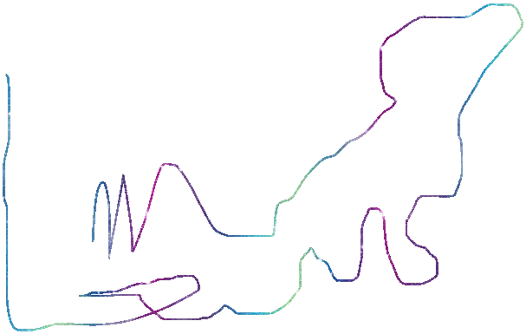
Unlike programming languages such as Java, C++, and Fortran, it is legal in MATLAB to mix numerical and logical data in expressions. If a logical value is used in a place where a numerical value is expected, true values are converted to 1, and false values are converted to 0 and then used as numbers.

Slide 6
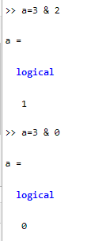
If a numerical value is used in a place where a logical value is expected, nonzero values are converted to true, and 0 values are converted to false and then used as logical values.

Slide 7
The logical data values are also produced by two types of MATLAB operators:
Relational operators
Logic operators.

Slide 8
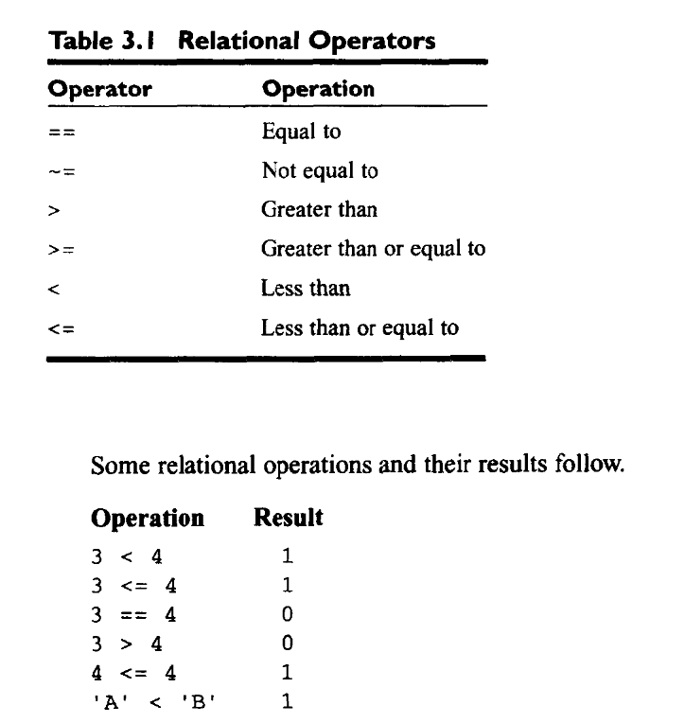
RELATIONAL OPERATORS (==, ~=, >, < , >=, <=)
Some relational operations and their results
If the relationship between two arithmetic expressions, variables or string operands by the operator is true, then the operation returns a true value; otherwise, the operation returns false.

Slide 9
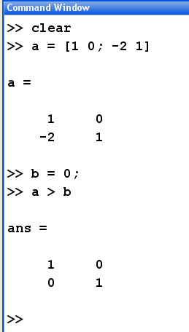
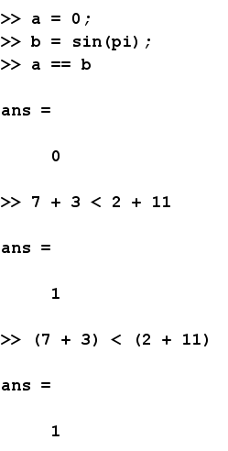
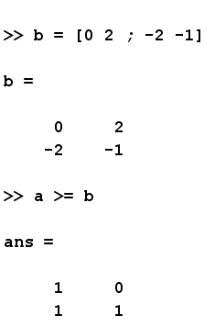
RELATIONAL OPERATORS (==, ~=, >, < , >=, <=)
Compare array by a value
Compare array by another one (of the same size)
Be careful because of roundoff errors

Slide 10
LOGICAL OPERATORS
Operator | Operation
& | Logical AND (scalar/array, both sides evaluation)
&& | Logical AND (scalar, left then right side evaluation)
| | Logical inclusive OR (scalar/array both sides evaluation)
|| | Logical inclusive OR (scalar, left then right side evaluation)
xor | Logical exclusive OR
~ | Logical NOT

Slide 11
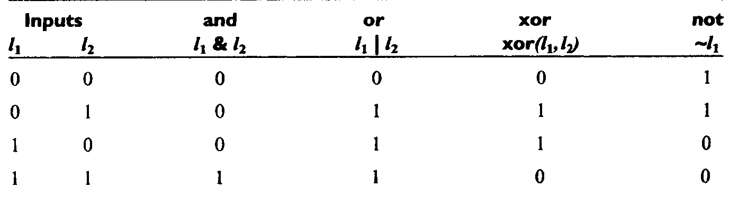
Truth Tables for Logic Operators

Slide 12
Example: Assume that the following variables are initialized with the values shown, and calculate the result of the specified expressions:
value1 = true
value2 = false
value3 = 1
value4 = -10
value5 = 0
value6 = [1 2; 0 1]

Slide 14
Hierarchy of Operations
Logic operators are evaluated after all arithmetic operations and all relational operators have been evaluated. The order in which the operators in an expression are evaluated is as follows:
1. All arithmetic operators are evaluated first in the order previously described.
2. All relational operators (==, ~=, >, >=, <, <=) are evaluated, working
from left to right.
3. All ~ operators are evaluated.
4. All & and && operators are evaluated, working from left to right.
5. All |, ||, and xor operators are evaluated, working from left to right.
As with arithmetic operations, parentheses can be used to change the default order of evaluation. (Now, see the previous slide again…)

Slide 15
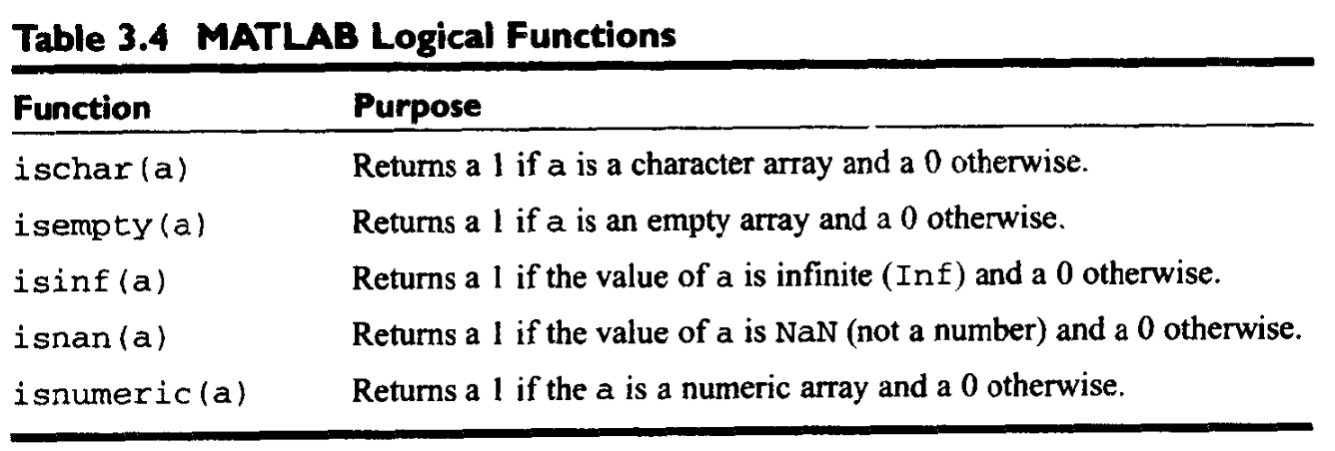
LOGICAL FUNCTIONS

Slide 16
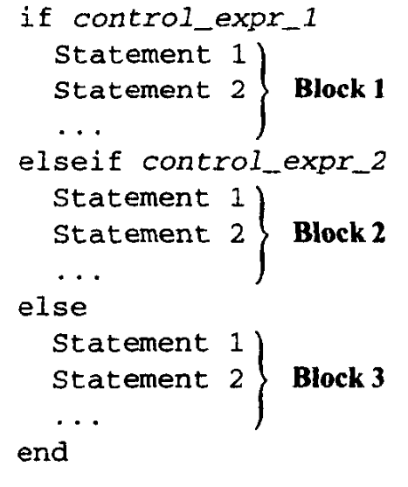
BRANCHES 1. (if-STATEMENT)
Optional

Slide 17
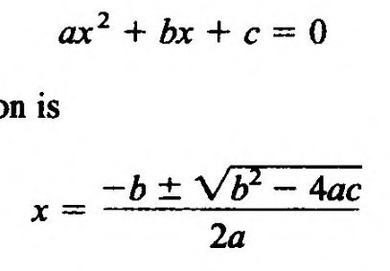
Example1 :
Write a program that determine whether a quadratic equation:
has real (identical/different) or complex roots. (Use input command for entering the coefficients (a,b,c) and disp commands to display the output).

Slide 18
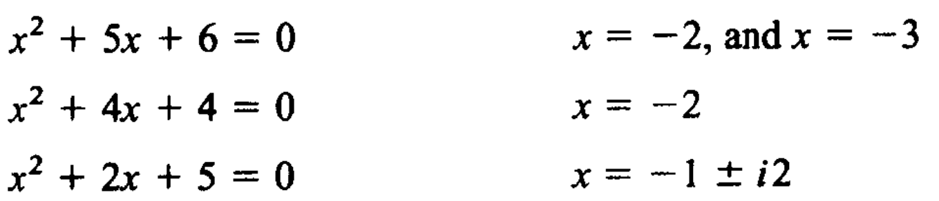
Example2 :
Write a program that calculates the roots in each case. (Use input command for entering the coefficients of the equation and disp commands to display the output).
Test the program on the following equations:

Slide 19
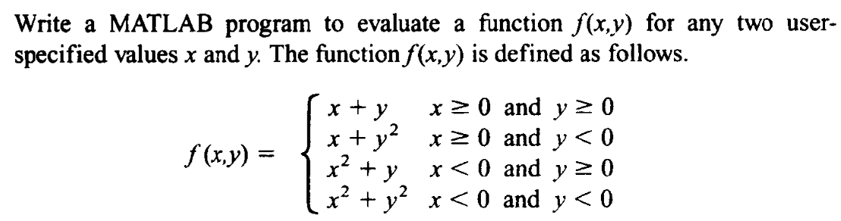
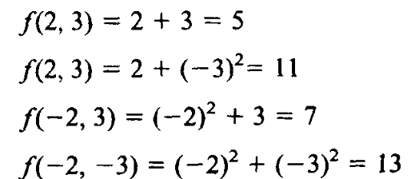
Example3 :
Test it using the following (x,y) values:

Slide 20
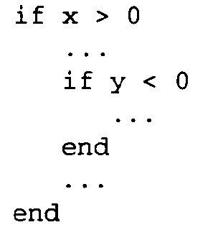
Nested if-Statements
It is preferable to use if-else-end statement whenever is possible

Slide 21
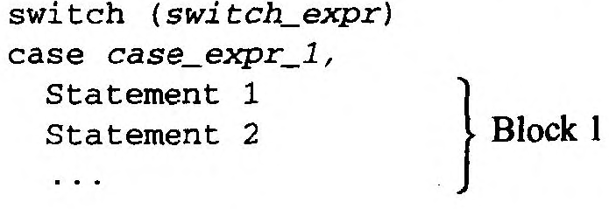
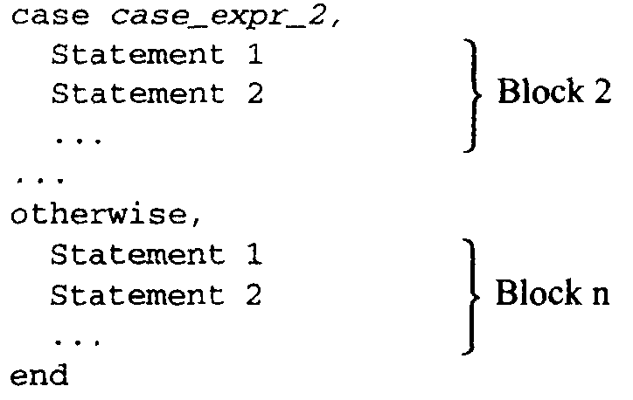
2. (switch-STATEMENT)
The switch_expr and case_expr may be a scalar or a string
The switch statement syntax is a means of conditionally executing code. In particular, switch executes one set of statements selected from an arbitrary number of alternatives.
Optional

Slide 22
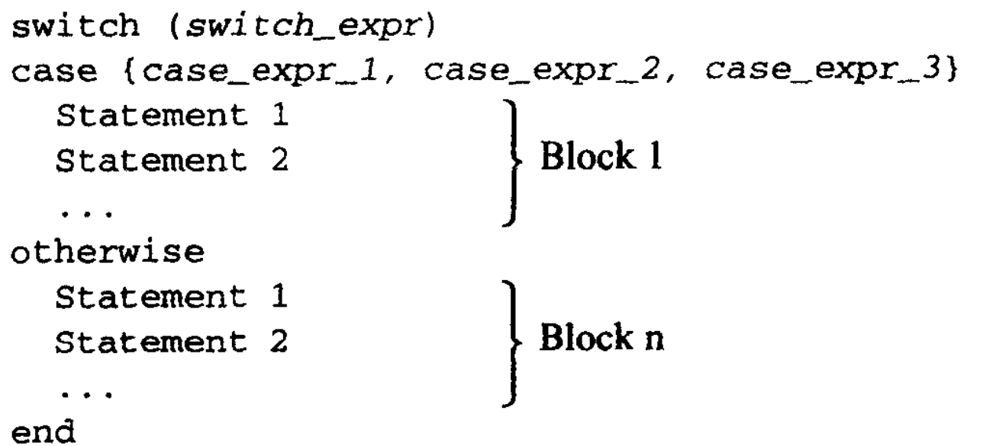
If many values of the switch_expr should cause the same code to execute, all of those values may be included in a single block by enclosing them in brackets, as shown in the following statements. If the switch expression matches any of the case expressions in the list, then the block will be executed.

Slide 23
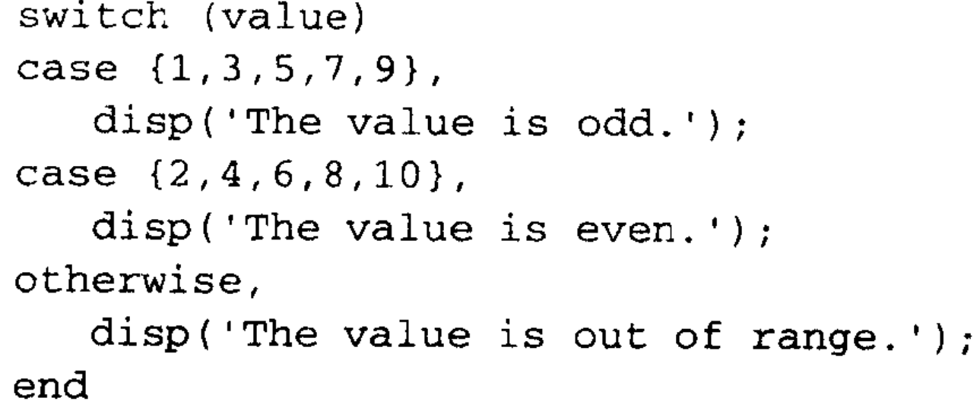

Example1 :

Slide 24
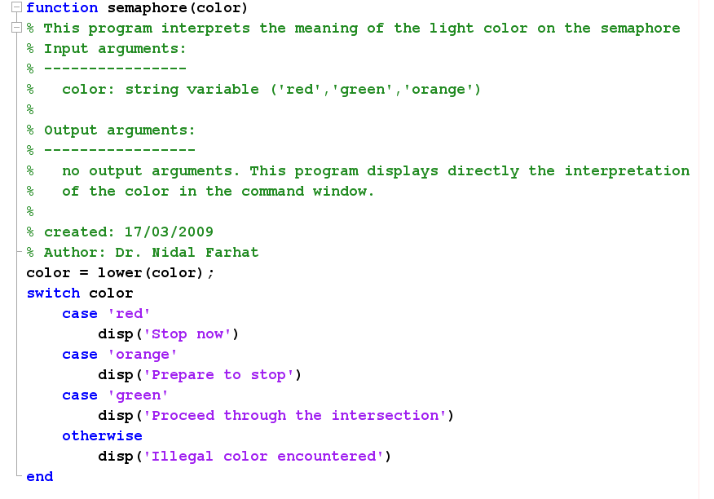
Example2 :

Slide 25


3. (try/catch)
The try/catch statement is designed to trap errors.
In MATLAB, when an error is encountered while running the program the program execution is aborted.
Use try/catch statement to run a part of the program susceptible to produce error when executed. MATLAB will try to execute this part.

Slide 26
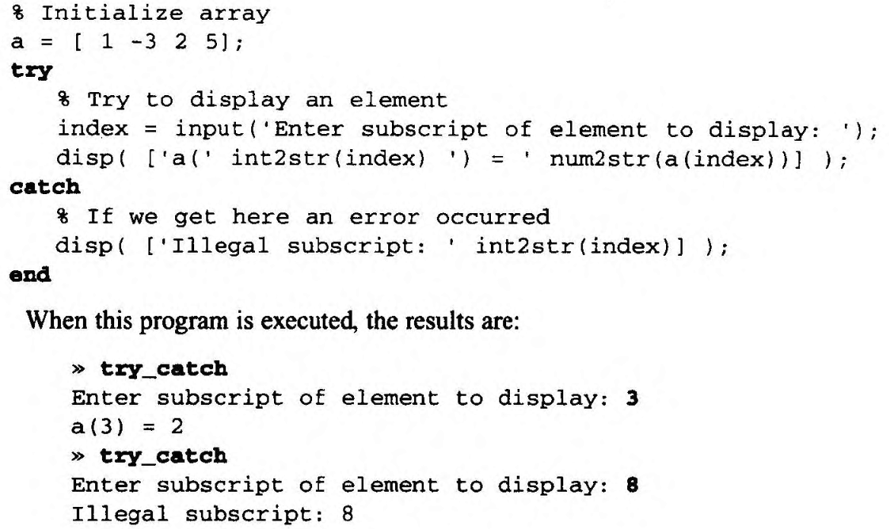


If an error is produced, then instead of aborting, it executes the part of the program found in the catch statement.
If no error is produced in the try block, the catch block will not be executed.

Slide 27
Plotting Features
Read 2.11 from Chapman Book

Slide 28
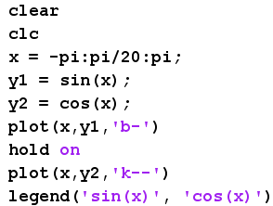
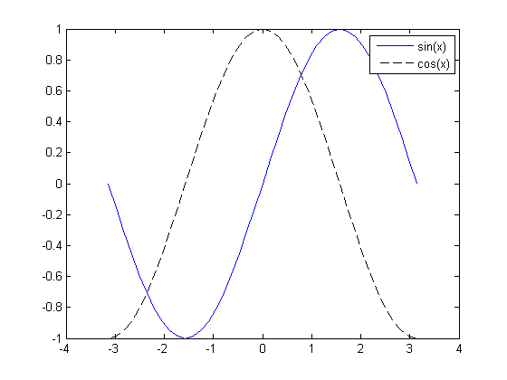
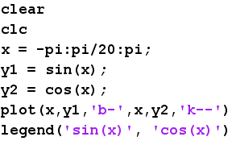
Plotting Multiple Plots on the Same Axes
OR

Slide 29
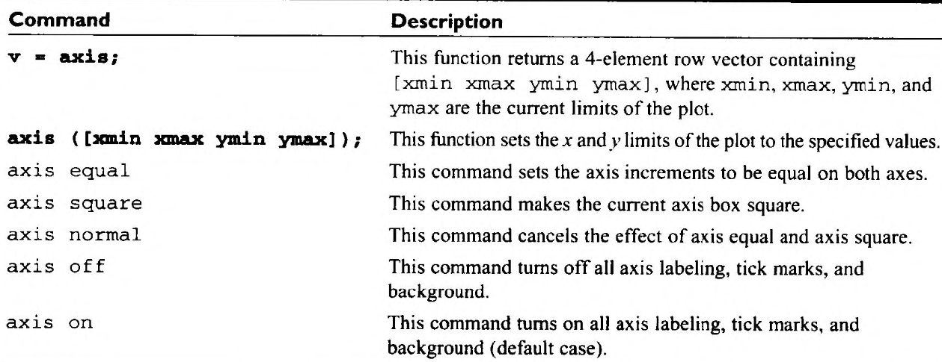



Example: f(x) = sin(x), from -2π to 2π
Then restrict the axes to the region 0 ≤ x ≤ π, and 0 ≤ y ≤ 1

Slide 30
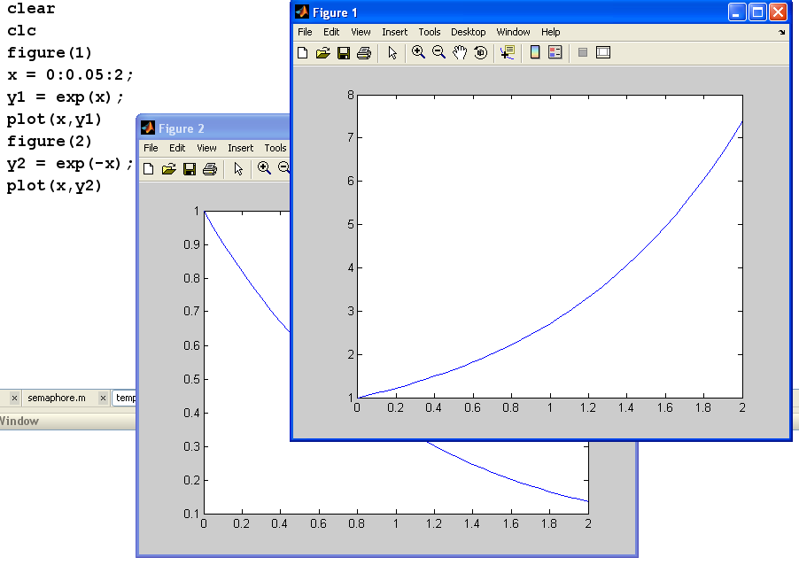
Creating Multiple Figures

Slide 31
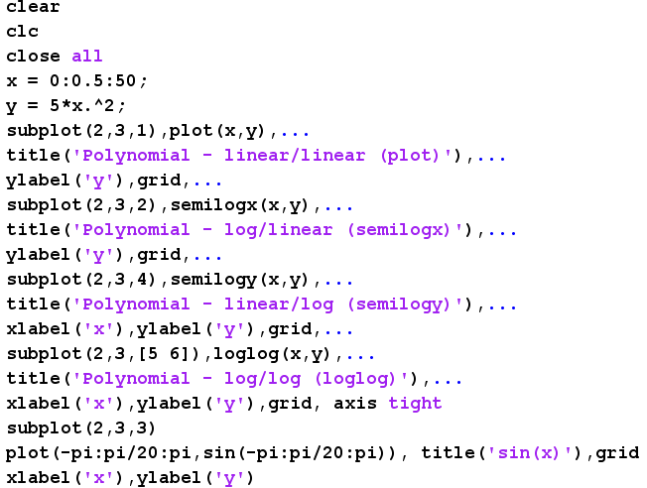
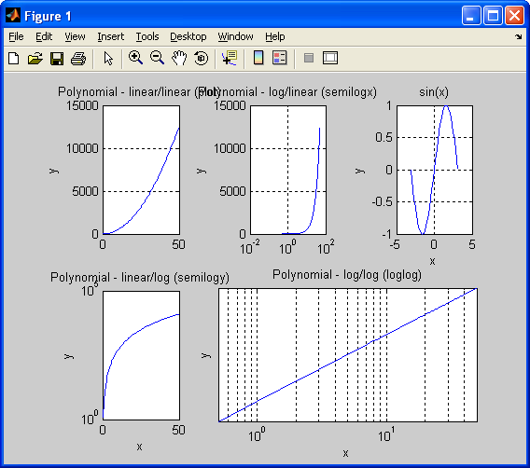
Subplots: Subplot(m,n,p) ≡ creates mxn subplots in the current figure (array of subplots), m rows and n columns. p is the current subplot.

Slide 32

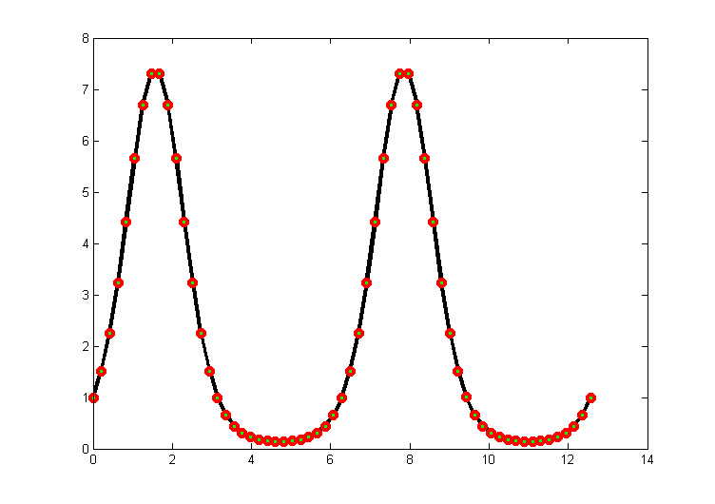
Enhanced Control of Plotted Lines
LineWidth specifies the width of each line in points.
MarkerEdgeColor specifies the color of the marker or the edge color for filled markers.
MarkerFaceColor specifies the color of the face of filled markers.
MarkerSize specifies the size of the marker in points.

Slide 33
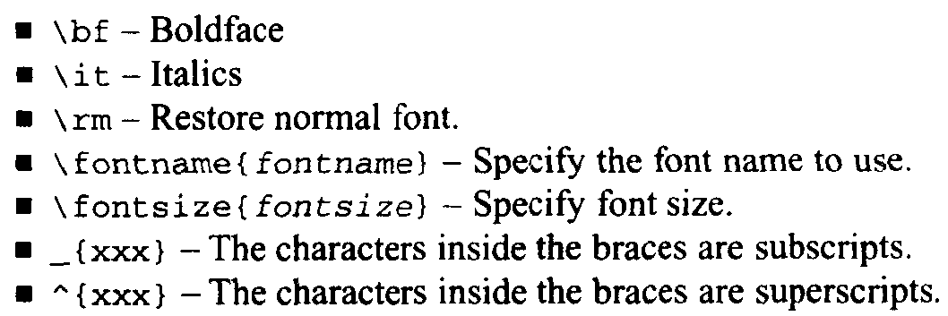
Enhanced Control of Text Strings

Slide 34
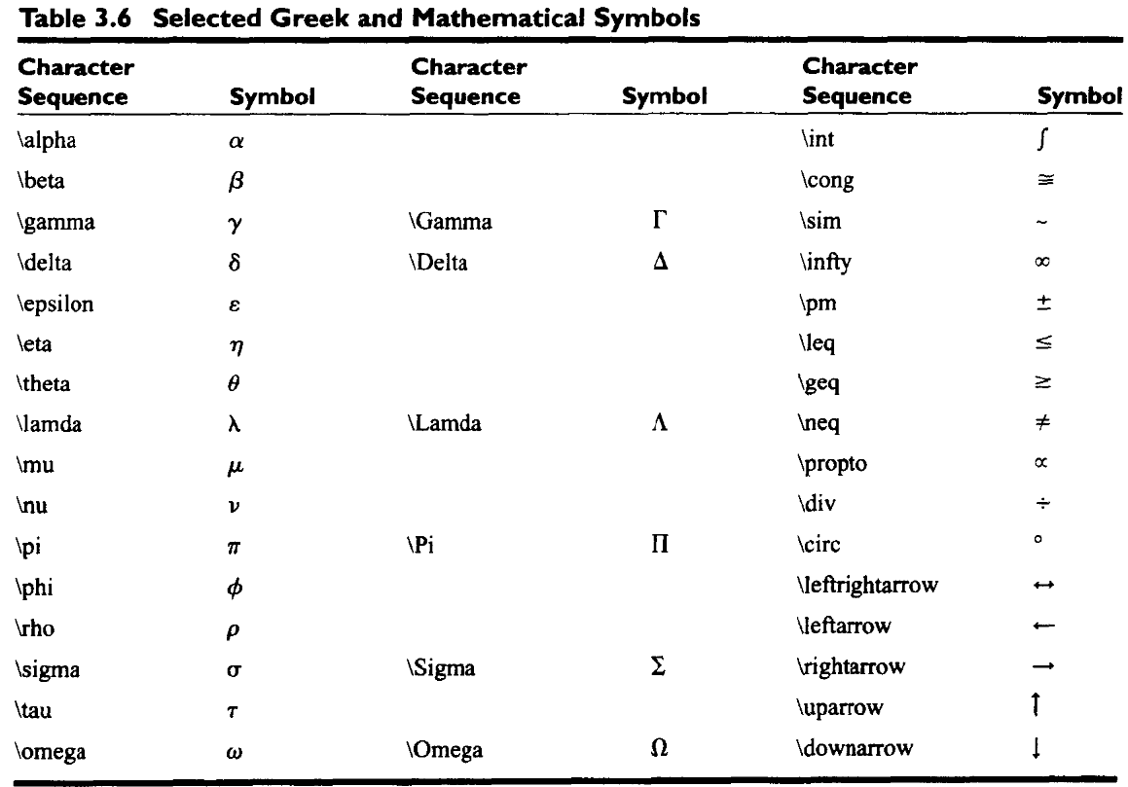
Enhanced Control of Text Strings

Slide 35
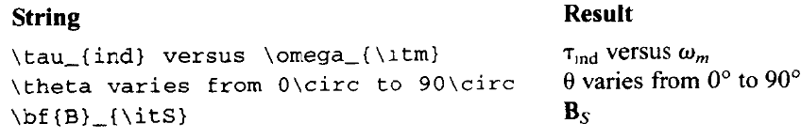
Examples:

Slide 36


Polar Plots
MATLAB includes a special function called polar, which plots data in polar coordinates. The basic form of this function is
polar(theta,r)
Where, theta is an array of angles in radians and r is an array of distances. It is useful for plotting data that is intrinsically a function of angle.

Slide 37
Example: Most microphones designed for use on a stage are directional microphones, which are specifically built to enhance the signals received from the singer in the front of the microphone while suppressing the audience noise from behind the microphone. The gain of such a microphone varies as a function of angle according to the equation
Where, g is a constant associated with a particular microphone, and q is the angle from the axis of the microphone to the sound source. Assume that g is 0.5 for a particular microphone, and make a polar plot the gain of the microphone as a function of the direction of the sound source.

Slide 38
